Slide 1

Title Page
22MAT230-Mathematics for Computing 4 Preconditioning Technique for an Image Deblurring Problem with the Total Fractional-Order Variation Model
CCB.SC.U4AIE24243 PRAVEEN REDDY
CB.SC.CU4AIE24241 POLICE.ARYAN
CCB.SC.U4AIE24230 JITHIN REDDY
CCB.SC.U4AIE24215 DEEPIKA REDDY

Slide 2
Introduction
Image deblurring is an ill-posed inverse problem
Classical methods amplify noise and blur edges
Regularization is required for stable reconstruction
Total Variation (TV)
TV preserves edges
But introduces staircase artifacts
Smooth intensity regions become piecewise constant
TFOV
Fractional derivatives are nonlocal
Provide a balance between:
Edge preservation
Smooth transitions
Reduce staircase effect significantly

Slide 3
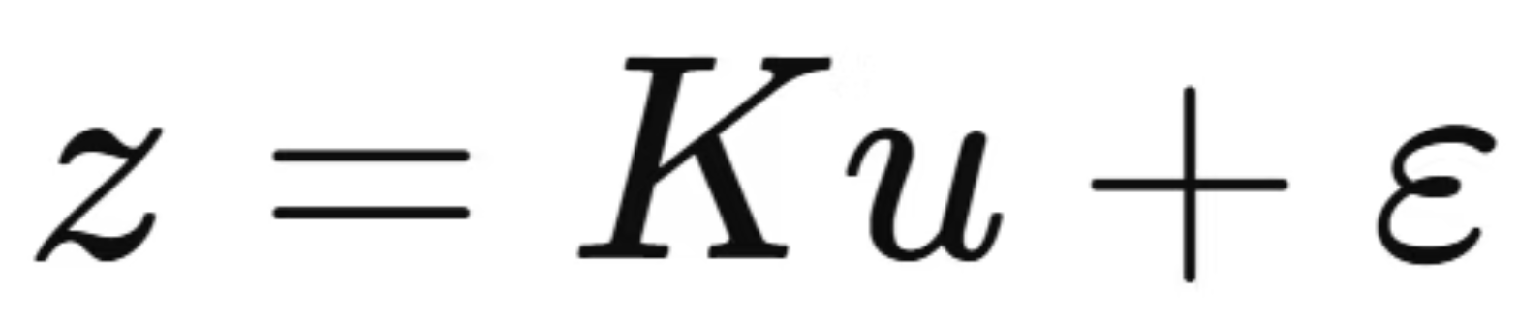
Image Deblurring Problem Formulation
Forward model
K is compact (information loss)
Small noise → large reconstruction errors
Direct inversion is unstable

Slide 4
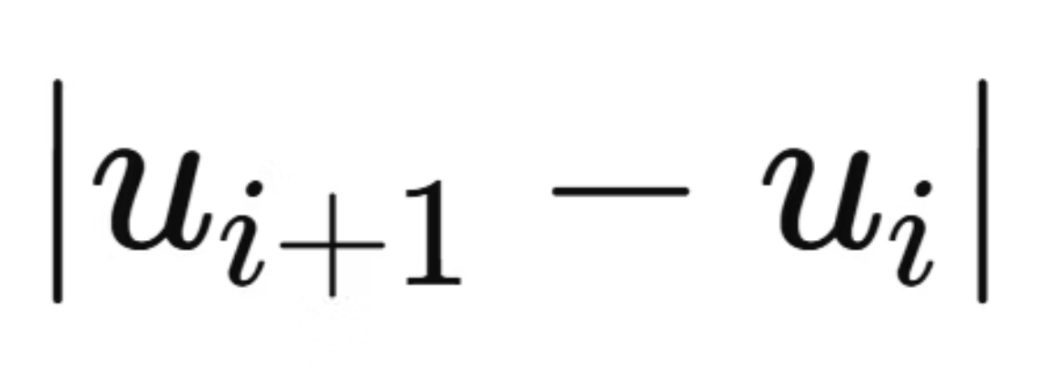
Toy Example: Why TFOV is Needed
Consider a 1D signal
True signal: smooth ramp with edges
TV minimizes first-order differences
TV behavior
Penalizes
Encourages piecewise constant solutions
Leads to staircase effect
TFOV intuition
Uses fractional-order differences
Each pixel depends on many neighbors
Produces smooth ramps + sharp edges
TFOV generalizes TV by controlling smoothness via order alphaα

Slide 5
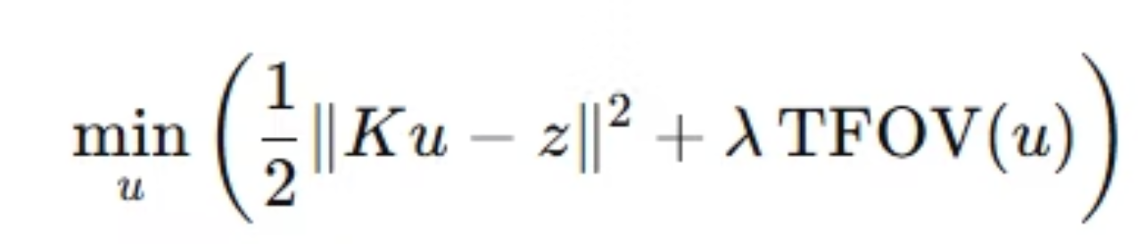
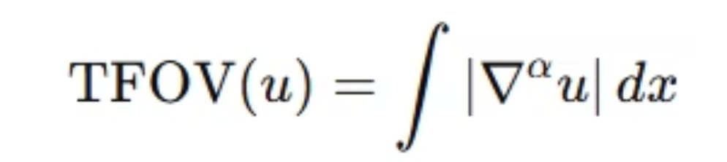
TFOV Variational Model
Optimization problem
Ensures reconstructed image matches observations
Penalizes deviation from measured data
TFOV regularization
Alpha=1 → classical TV
Alpha>1 → smoother transitions, less staircasing

Slide 6
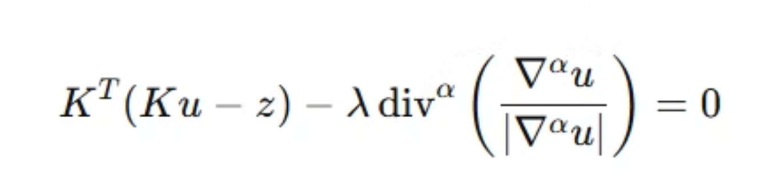
Euler–Lagrange Equations
Gradient of the data fidelity term and regularization
Measures mismatch in observation space
Correct the image using the blur error
Smooth flat regions and protect edges

Slide 7
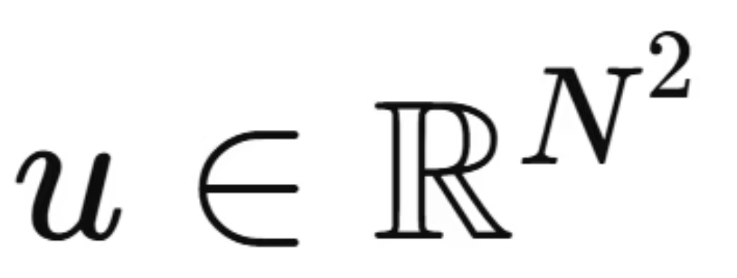
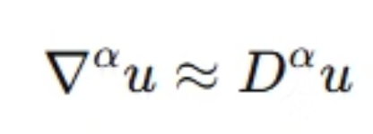
Discretization
Spatial discretization
Domain divided into N×N grid
Image stored as vector
Fractional derivatives
Approximated using shifted Grünwald–Letnikov scheme
Leads to matrices:

Slide 8
Linearization
Problem
Lα​(u)depends on u
Solution: Fixed-Point Iteration
At iteration m:
Freeze nonlinear denominator
Solve a linear system at each step
Converges in very few iterations

Slide 9
Algorithm Overview
Forward model describes blur
Variational model adds stability
TFOV introduces nonlocal smoothness
Euler–Lagrange gives governing equation
Discretization converts to matrices
Fixed-point iteration handles nonlinearity
Preconditioning speeds up solution

Slide 10
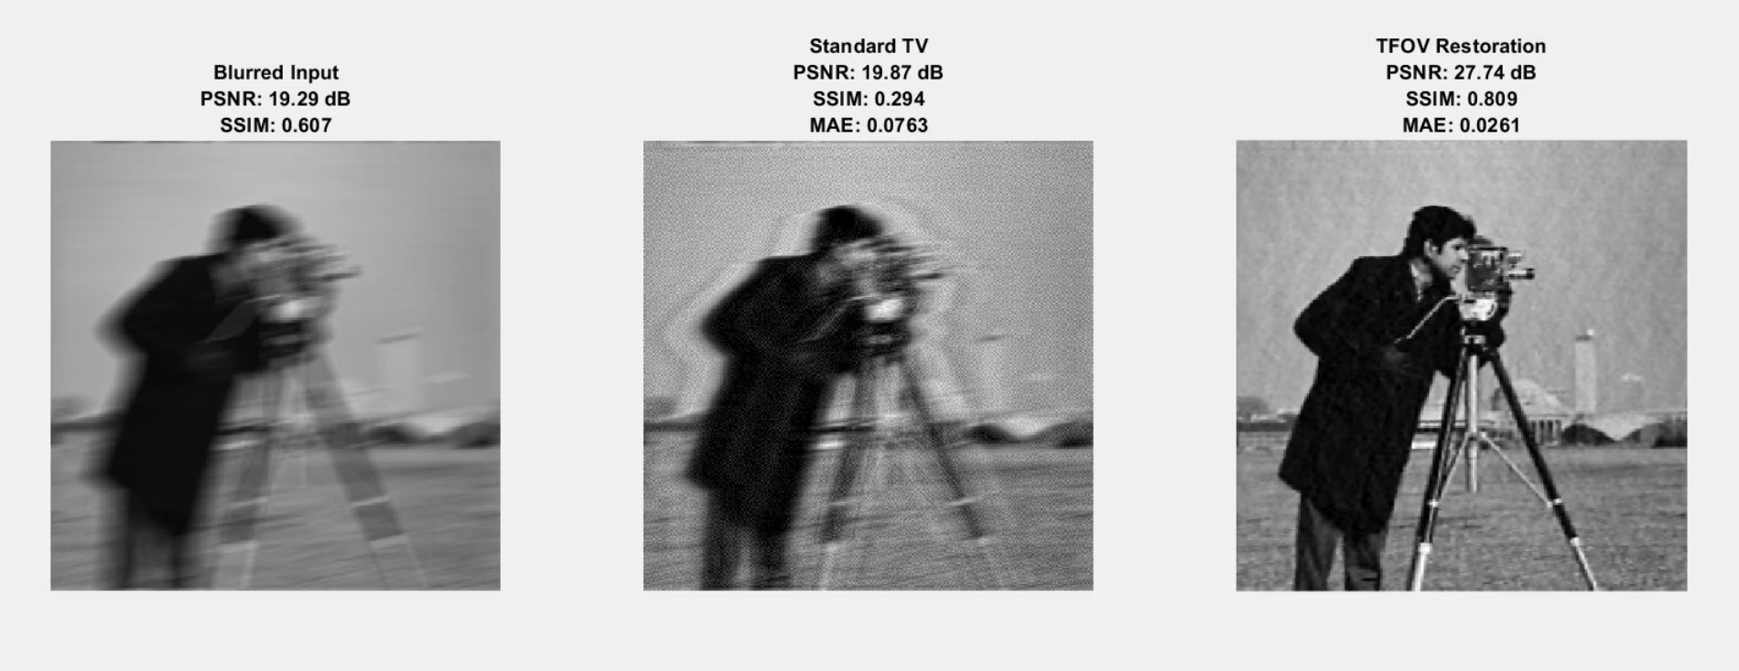
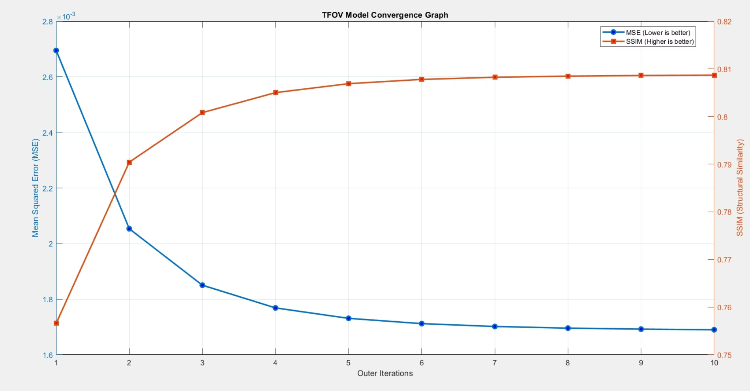
Results

Slide 11
Thank you

